Slide 1

Ratings Prediction Project
11-06-2022
Internship-24
Presented by: Ram kumar

Slide 2
Acknowledgement
Data Science with ML
SME -Khushboo Garg
Flip Robo Technology

Slide 3
What is Ratings Prediction Project?
We have a client who has a website where people write different reviews for technical products. Now they are adding a new feature to their website i.e. The reviewer will have to add stars(rating) as well with the review
The rating is out 5 stars and it only has 5 options available 1 star, 2 stars, 3 stars, 4 stars, 5 stars. Now they want to predict ratings for the reviews which were written in the past and they don’t have a rating. So, we have to build an application which can predict the rating by seeing the review.

Slide 4
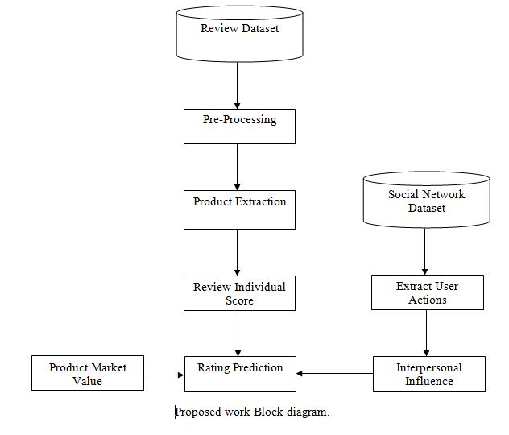
Ratings Prediction Project Diagram:

Slide 5
Analytical Problem in dataset

Slide 6
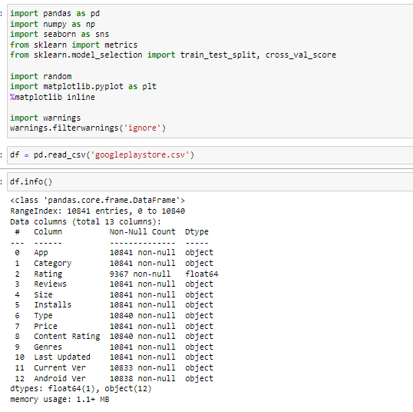
Import library and load the dataset

Slide 7
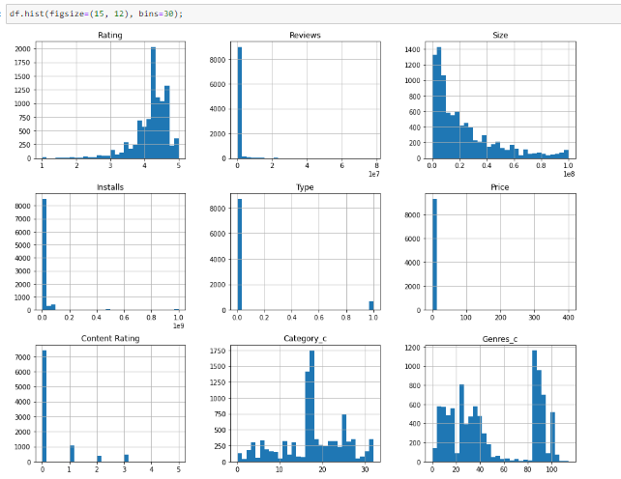
Graphs:
This histplot gives numbers of counts and showing that which is more interesting.
.

Slide 8
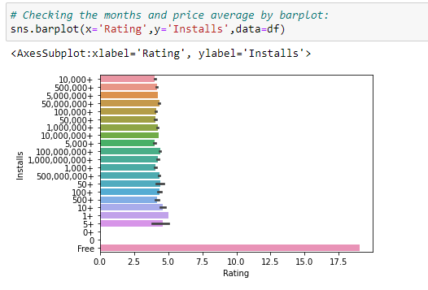
Graphs:
Here Showing Rating and install values.

Slide 9
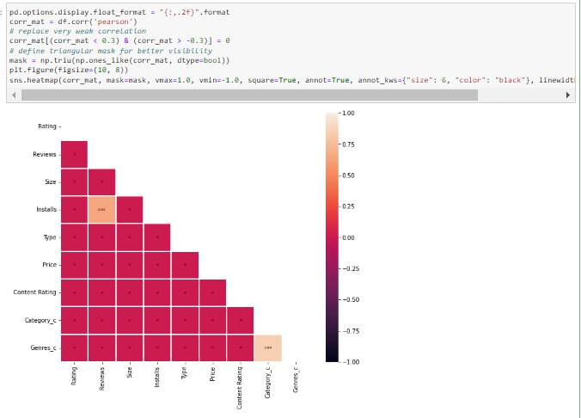
Correlation:

Slide 10
Graphs:

Slide 11
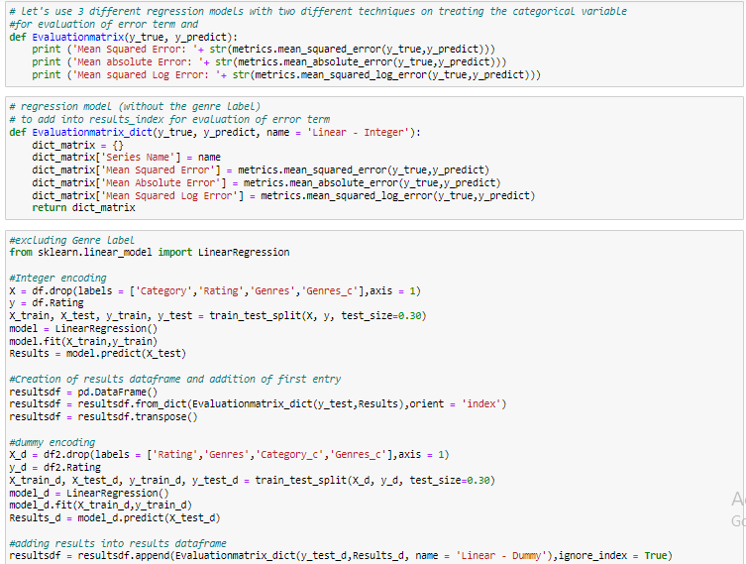
Model/s Development and Evaluation

Slide 12
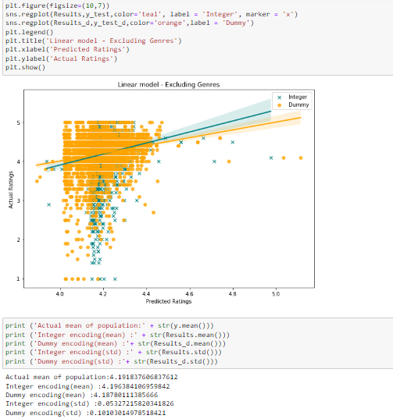
Testing of Identified Approaches (Algorithms):
.

Slide 13
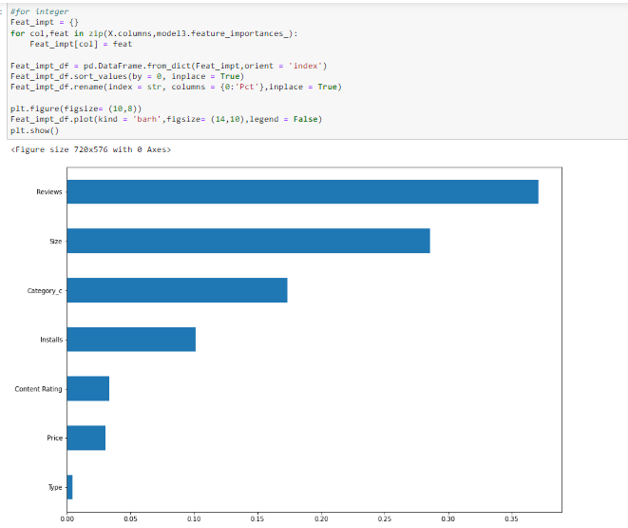
diagram of Evaluate selected models

Slide 14
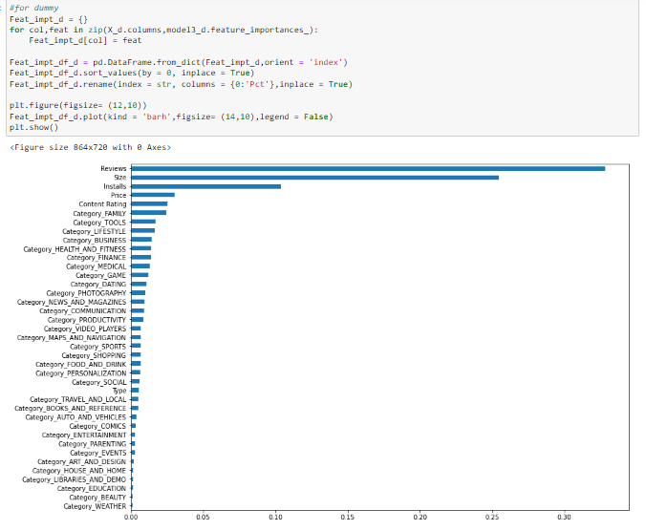
higher overall predicted mean :

Slide 15
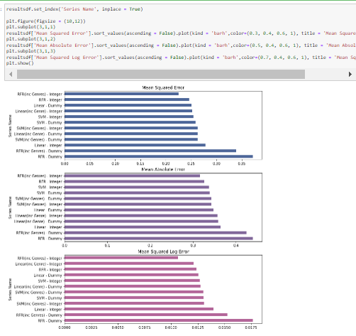
higher overall predicted mean :

Slide 16
CONCLUSION :
It is not easy to conclude which model has the best predictive accuracy and lowest error term. Using this round of data as a basis, the dummy encoded SVM model including genres has the lowest overall error rates, followed by the integer encoded RFR model including genes. Yet, all models seem to be very close in terms of it's error term, so this result is likely to change.
What is very surprising to me is how the RFR dummy model has such a significantly more error term compared to all the other models, even though on the surface it seemed to perform very similarly to the RFR integer model.

